Slide 1

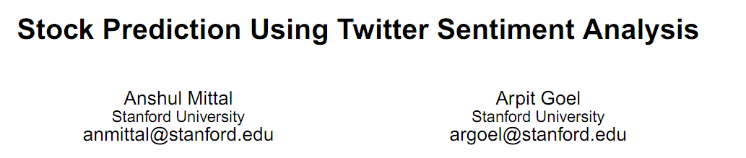
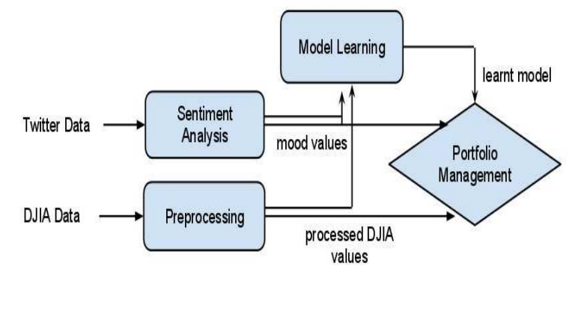


DJIA (Dow Jones Industrial Average)
# 2009 June ~ 2009 December
# Data from Yahoo!
Twitter Data
# 2009 June ~ 2009 December
# 476 million tweets

Slide 2
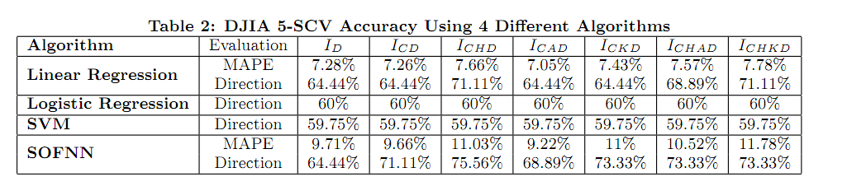
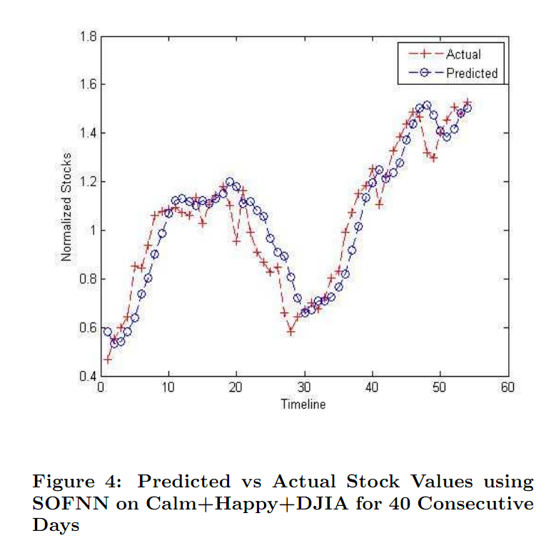

Slide 3
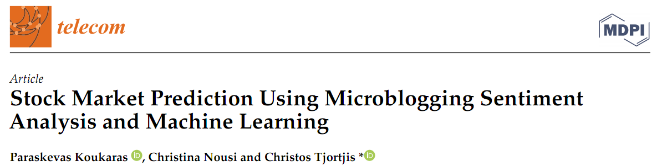
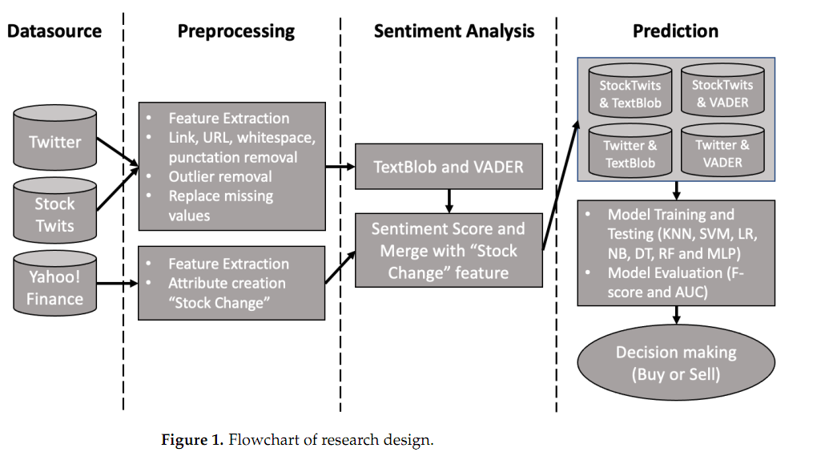

Slide 4
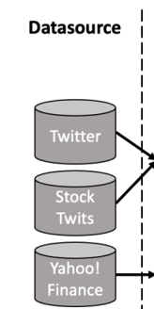
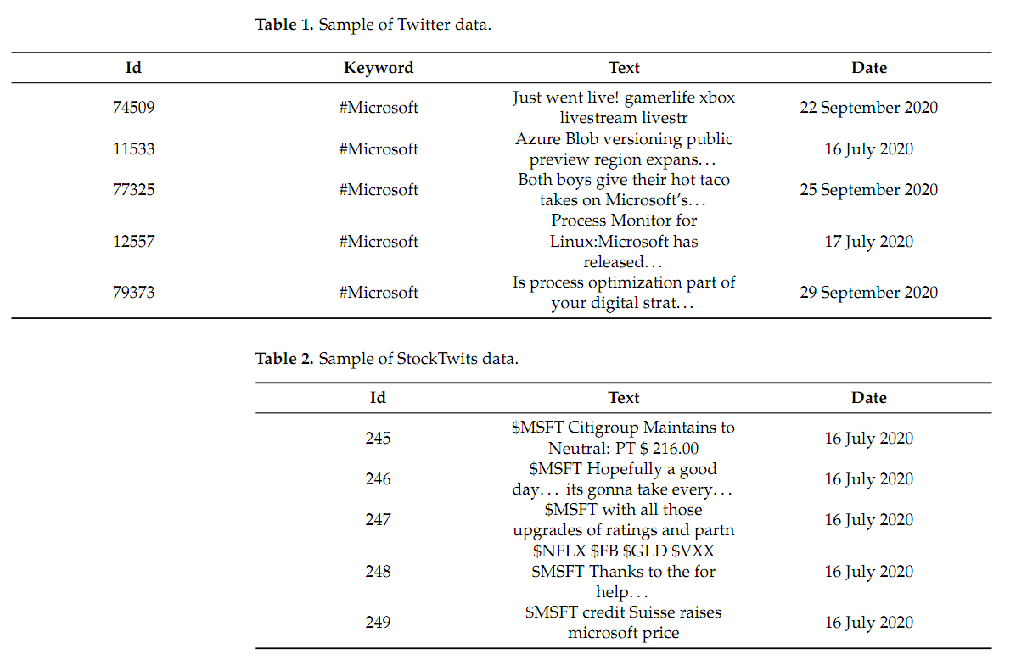
Microsoft’s stock price
# 2020 July 16 ~ 2020 October 31 (108days)
# Data from Yahoo!
Twitter Data
# 2020 July 16 ~ 2020 October 31 (108days)
# Using English tag
#Microsoft, #MSFT, #Microsoft365
# 90,000 tweets
StockTwits Data
# 2020 July 16 ~ 2020 October 31 (108days)
# 7,440 tweets

Slide 5
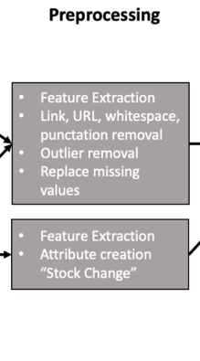

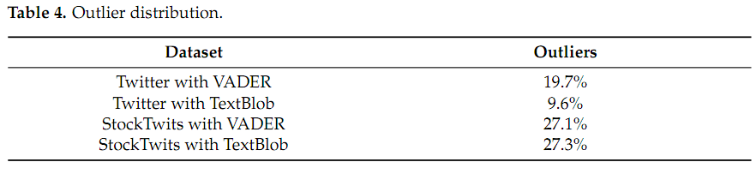

= 불필요 기호 제거 (ex. @, $, URL etc)
= 데이터 표준화, to make data point at same range and variability
= 트위터에는 7일 제한 정책 존재 -> 모든 날짜에서 데이터 수집 제한
+ 주말의 경우 주식장 운영 x -> 빈 데이터를 Linear Interpolation으로 채움

Slide 6
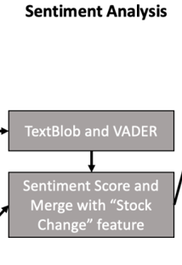


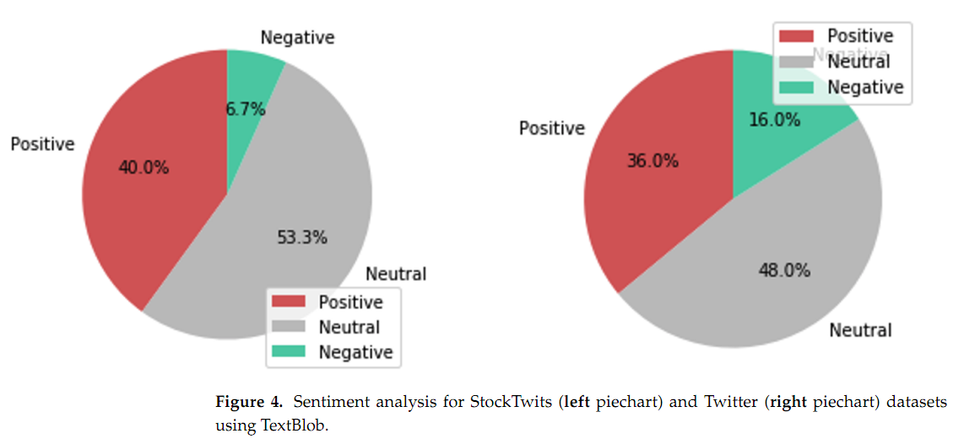
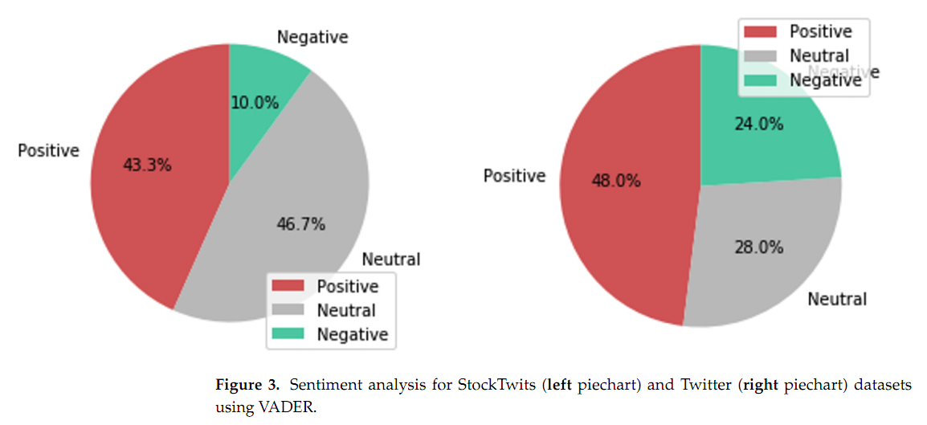
감성분석 도구 2가지 = VADER, TextBlob (Python Packages)
Compound score = negative + positive + neutral lexical evaluation

Slide 7
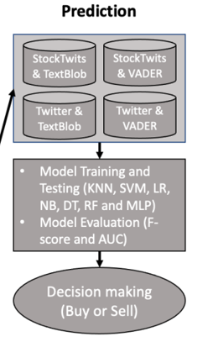

사용한 분류 알고리즘
# KNN (K-최근접 이웃 알고리즘)
# SVM (Support Vector Machine)
# LR (Logistic Regression)
# NB (Naïve Bayer)
# DT (Decision Tree)
# RF (Random Forest)
# MLP (Multi Layer Perceptron)
검증 모델
# F-score
# AUC

Slide 8
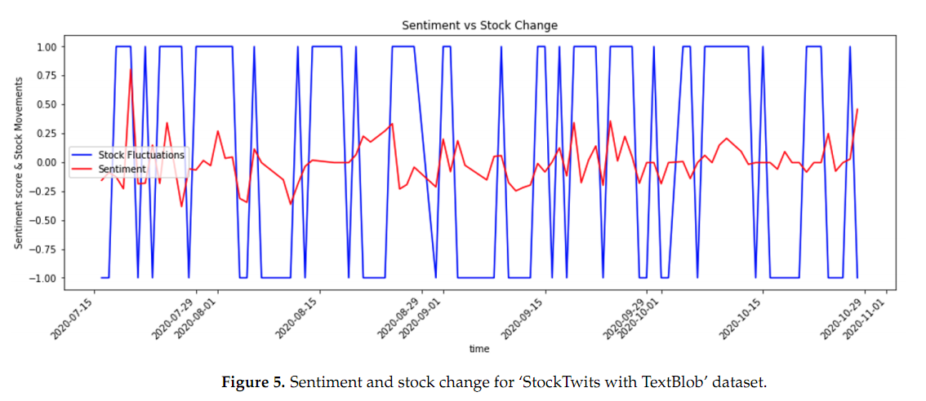
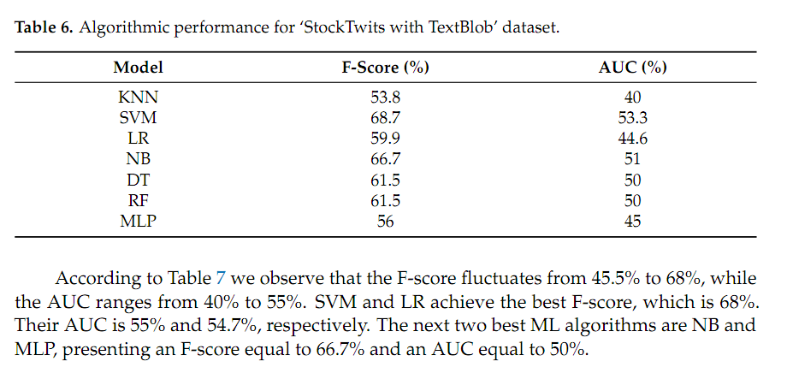
StockTwits
+
TextBlob

Slide 9
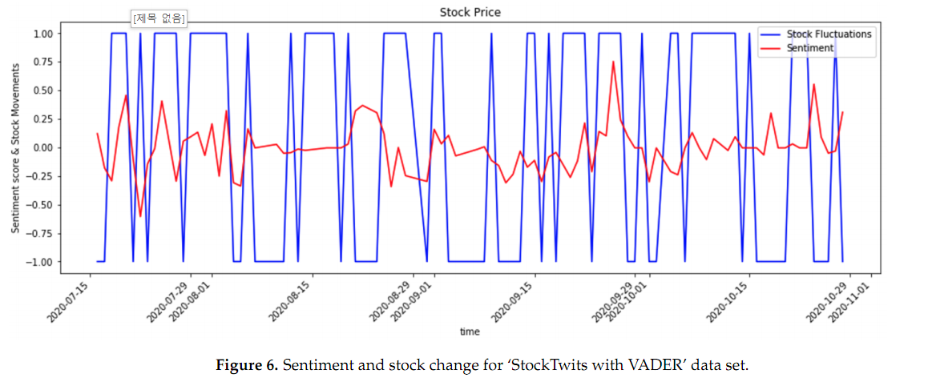
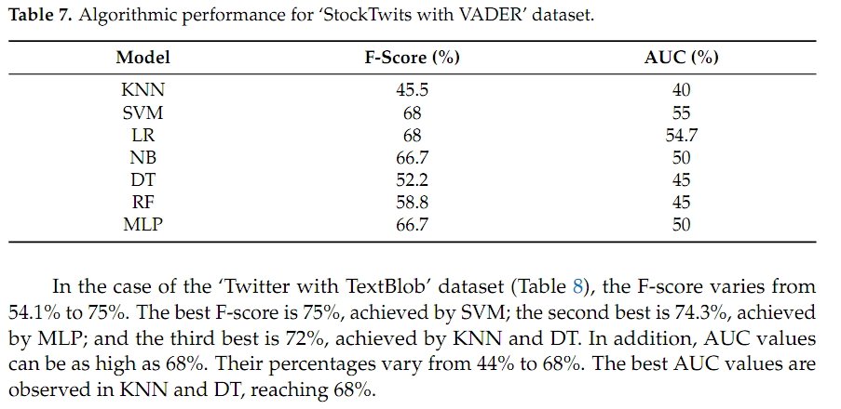
StockTwits
+
VADER

Slide 10
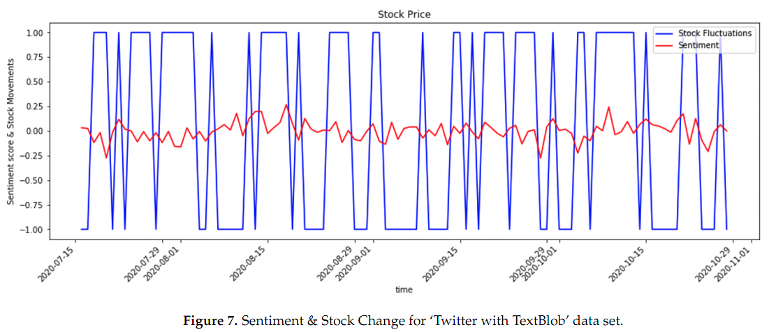
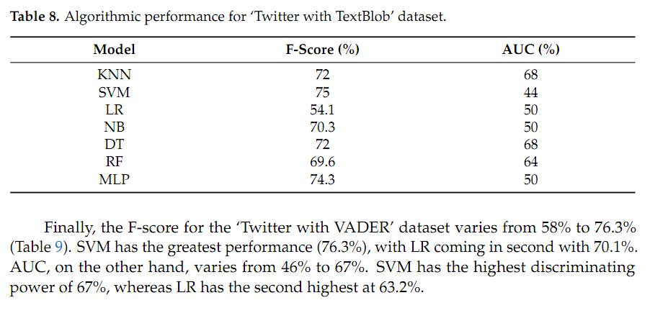
Twitter
+
TextBlob

Slide 11
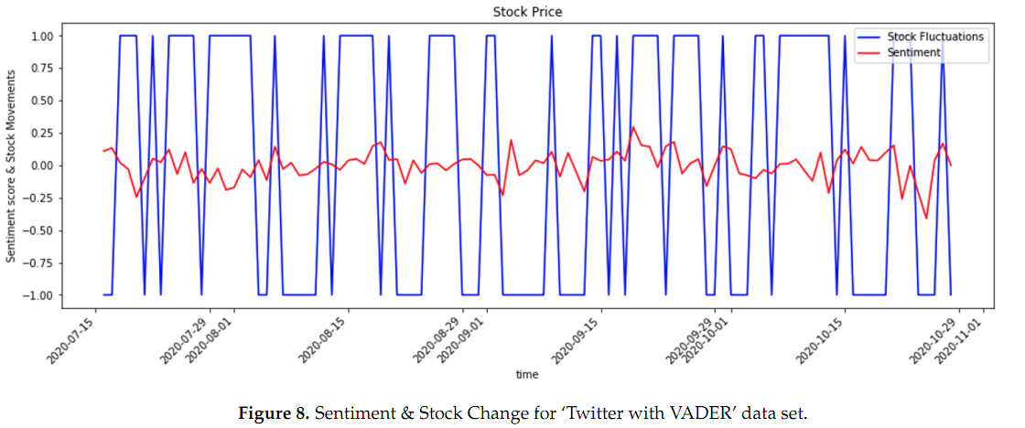
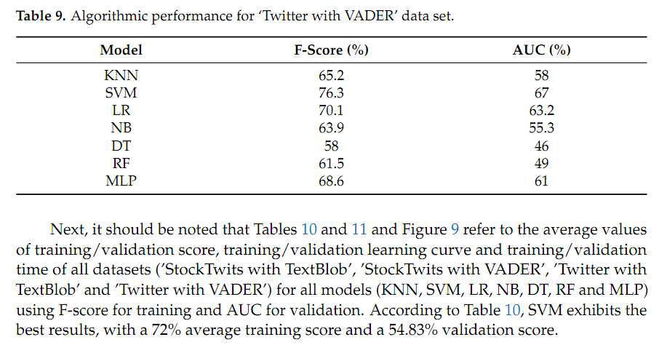
Twitter
+
VADER

Slide 12
